Slide 1
Dungeon Organizer
By
The Gnolls
Presenter: Widler
Notes:
Russell

Slide 2
Team Members
Jacqueline Munroe - Project Lead
Michael Dunton - Scrum Master
Toyanne Bennett - Documentation
Widler Rislin - Database Programmer
Russell Stephenson - Programmer
Notes:
Russell

Slide 3
Project Description
Development of an interactive website for players of Dungeons & Dragons 3.5, that allows for:
Creation/Management of Character Sheets
Searching for spells, items, races, classes, feats, etc.
Creation of Parties Comprised of a Dungeon Master (DM) and Players
Conversation and Long-Distance Play via a Bulletin Board

Slide 4
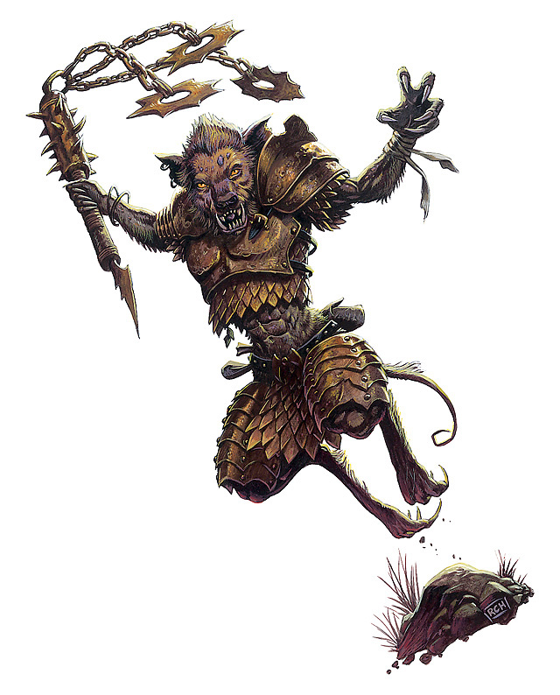
Collaboration
Github
https://github.com/gnolls/Yeenoghu

Slide 5
Schedule

Slide 6
This Week's Accomplishments
Virtual Meeting 3/27/2013
Began to normalize some of our data for easy database entry
Purchased domain name
Built bridge between our codeigniter website and phpbb forum so user only need to login once to have access to both

Slide 7
Next week
Finish designing website
Finish designing our Forum
Complete the task of normalizing the database
Begin the tedious process of data entry

Slide 8
Expended cost to date
60 Hours (@ $37.50/hr)
2250
Server Costs
$60/year + $9.95 for domain name.
Running Total
$1194.95

Slide 9
Issues not resolved
Dungeons and dragons has a large number of spells and attributes
Normalizing data will be complicated
Data entry will be VERY tedious

